Slide 1

Teaching Resources and Instructors’ Guidelines
Chapter 1: The innovation imperative

Slide 2

In the following PowerPoint slides you will find the key headings from CHAPTER 1 together with the main illustrations, tables, etc.
There are also slides summarizing the key messages in bullet-point fashion, links to videos and a wide range of activities which you can use to help students explore around these themes.
Finally there are some reflection questions which can be used as the basis for discussion or assignments.
Chapter 1: The innovation imperative

Slide 3
Learning objectives
By the end of this chapter you will develop an understanding of:
what ‘innovation’ and ‘entrepreneurship’ mean and how they are essential for survival and growth
innovation as a process rather than a single flash of inspiration
the difficulties in managing what is an uncertain and risky process
the key themes in thinking about how to manage this process effectively

Slide 4

Core themes and material from the book

Slide 5

Innovation?
The word ‘innovation’ comes from the Latin, innovare, and is all about change.
Perhaps a more helpful definition of innovation is:
‘the process of creating value from ideas’

Slide 6
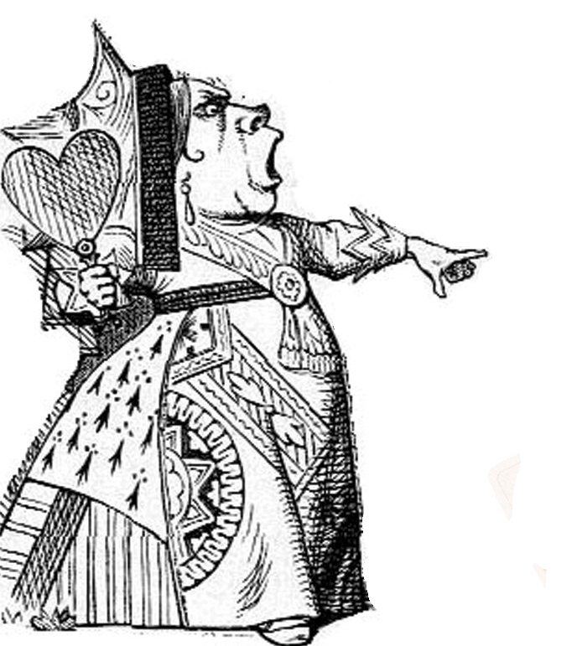
The innovation imperative
‘A slow sort of country’ said the Red Queen. ‘Now here, you see, it takes all the running you can do to keep in the same place. If you want to get somewhere else, you must run at least twice as fast as that!’
(Lewis Carroll, Alice through the Looking Glass)

Slide 7
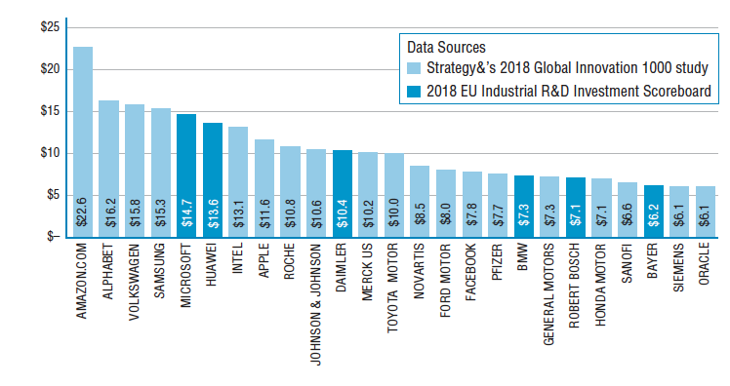
Global R&D spend

Slide 8

Innovation and entrepreneurship
‘Innovation is the specific tool of entrepreneurs, the means by which they exploit change as an opportunity for a different business or service. It is capable of being presented as a discipline, capable of being learned,capable of being practised’
(Peter Drucker)

Slide 9
Innovation & Entrepreneurship
Stage in life cycle | Start-up | Growth | Sustain/scale | Renew
Creating wealth | Individual entrepreneur exploiting new technology or market opportunity | Growing the business through adding new products/services or moving into new markets | Building a portfolio of incremental and radical innovation to sustain the business and/or spread its influence into new markets | Returning to the radical frame-breaking kind of innovation which began the business and enables it to move forward as something very different
Creating social value | Social entrepreneur, passionately concerned to improve or change something in their immediate environment | Developing the ideas and engaging others in a network for change – perhaps in a region or around a key issue | Spreading the idea widely, diffusing it to other communities of social entrepreneurs, engaging links with mainstream players like public sector agencies | Changing the system - and then acting as agent for next wave of change

Slide 10
Hidden innovation
Type I: Innovation that is identical or similar to activities that are measured by traditional indicators, but which is excluded from measurement
Type II: Innovation without a major scientific and technological basis, such as innovation in organizational forms or business models.
Type III: Innovation created from the novel combination of existing technologies and processes.
Type IV: Locally-developed, small-scale innovations that take place ‘under the radar’, not only of traditional indicators but often also of many of the organizations and individuals working in a sector.

Slide 11
Type I: the development of new technologies in oil exploration.
Type II: the development of new contractual relationships between suppliers and clients on major construction projects.
Type III: the way in which banks have integrated their various back office IT systems to deliver innovative customer services such as Internet banking.
Type IV: the everyday innovation that occurs in classrooms and multidisciplinary construction teams
Examples of ‘hidden’ innovation

Slide 12
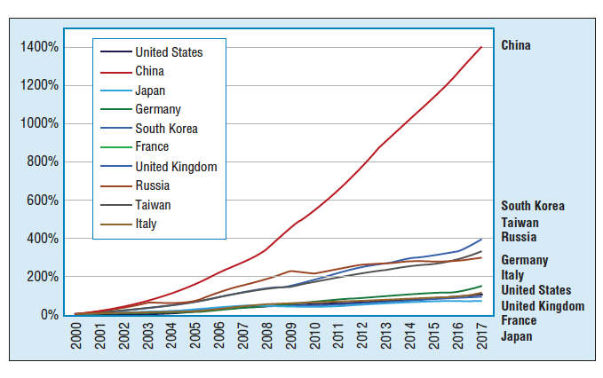
Investments in innovation

Slide 13
Challenges on the innovation horizon
Accelerating knowledge production
Globalisation of knowledge production
Market expansion – now <7billion people
Market globalization and fragmentation
Market virtualization
Rise of active users/demand for customization
Growing concern with sustainability challenges
Shifting technological and social infrastructures

Slide 14
Innovation isn’t easy
Barriers to innovation include:
  Seeing innovation as ideas, not managing the whole journey;
  Not recognizing the need for change;
  Mindset and complacency – core competence becomes core rigidity;
  Closed information network, insulated from new ideas.

Slide 15
Successful innovators...
Explore and understand
explore and understand different dimensions of innovation (ways in which we can change things)
Manage
manage innovation as a process
Create
create conditions to enable them to repeat the innovation trick (building capability)
Focus
focus this capability to move their organizations forward (innovation strategy)
Build
build dynamic capability (the ability to rest and adapt their approaches in the face of a changing environment)

Slide 16
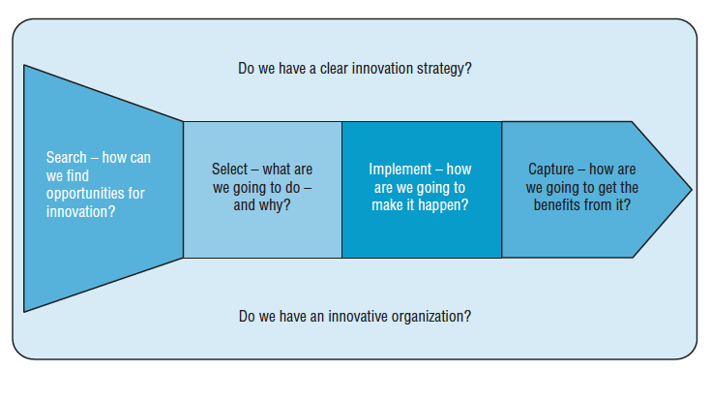
A process model for innovation

Slide 17
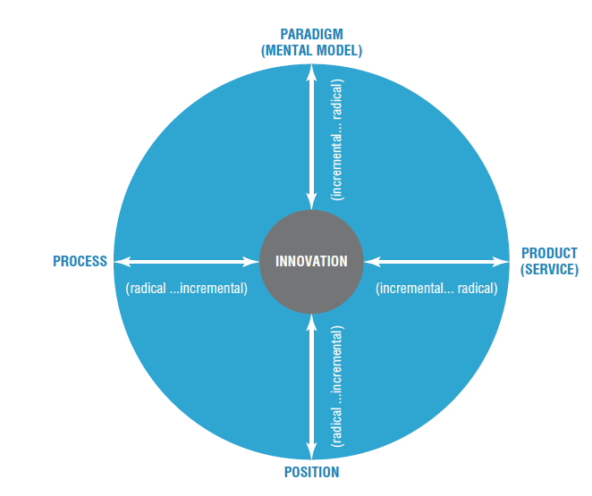
Scope for innovation

Slide 18
Dimensions of innovation – what can we change?
Dimension | Type of change
‘Product’ | Changes in the things (products/services) which an organization offers
‘Process’ | Changes in the ways in which these offerings are created and delivered
‘Position’ | Changes in the context into which the products/services are introduced
‘Paradigm’ | Changes in the underlying mental models which frame what the organization does

Slide 19
Examples of the 4Ps model: Product
‘Product’ – what we offer the world | Windows 7 and 8 replacing Vista and XP – essentially improving on existing software idea New versions of established car models – e.g. the VW Golf essentially improving on established car design Improved performance - incandescent light bulbs CDs replacing vinyl records – essentially improving on the storage technology | New to the world software – for example the first speech recognition program Toyota Prius – bringing a new concept – hybrid engines. Tesla – high performance electric car. LED-based lighting, using completely different and more energy efficient principles Spotify and other music streaming services – changing the pattern from owning your own collection to renting a vast library of music

Slide 20
Examples of the 4Ps model: Process
‘Process’ - how we create and deliver that offering | Improved fixed line telephone services Extended range of stock broking services Improved auction house operations Improved factory operations efficiency through upgraded equipment Improved range of banking services delivered at branch banks Improved retailing logistics | Skype and other VOIP systems On-line share trading eBay Toyota Production System and other ‘lean’ approaches Online banking and now mobile banking in Kenya, Philippines – using phones as an alternative to banking systems On line shopping

Slide 21
Examples of the 4Ps model: Position
‘Position’ – where we target that offering and the story we tell about it | HaagenDazs changing the target market for ice cream from children to consenting adults Airlines segmenting service offering for different passenger groups – Virgin Upper Class, BA Premium Economy, etc. Dell and others segmenting and customizing computer configuration for individual users On line support for traditional higher education courses Banking services targeted at key segments – students, retired people, etc. | Addressing underserved markets – for example the Tata Nano aimed at emerging but relatively poor Indian market with car priced around $2000. Low cost airlines opening up air travel to those previously unable to afford it – create new market and also disrupt existing one Variations on the ‘One laptop per child’ project – e.g. Indian government $20 computer for schools University of Phoenix and others, building large education businesses via online approaches to reach different markets ‘Bottom of the pyramid’ approaches using a similar principle but tapping into huge and very different high volume/low margin markets – Aravind eye care, Cemex construction products

Slide 22
Examples of the 4Ps model: Paradigm
‘Paradigm’ – how we frame what we do | Bausch and Lomb – moved from ‘eye wear’ to ‘eye care’ as their business model, effectively letting go of the old business of spectacles, sunglasses (Raybans) and contact lenses all of which were becoming commodity businesses. Instead they moved into newer high tech fields like laser surgery equipment, specialist optical devices and research in artificial eyesight Dyson redefining the home appliance market in terms of high performance engineered products Rolls Royce – from high quality aero engines to becoming a service company offering ‘power by the hour’ IBM from being a machine maker to a service and solution company – selling off its computer making and building up its consultancy and service side. | Grameen Bank and other microfinance models – rethinking the assumptions about credit and the poor iTunes platform – a complete system of personalized entertainment Cirque de Soleil – redefining the circus experience Amazon, Google, Skype – redefining industries like retailing, advertising and telecoms through online models Linux, Mozilla, Apache – moving from passive users to active communities of users co-creating new products and services

Slide 23
Dimensions of innovation
Incremental ←-→ Radical
Component and system
Architectures, platforms and systems

Slide 24
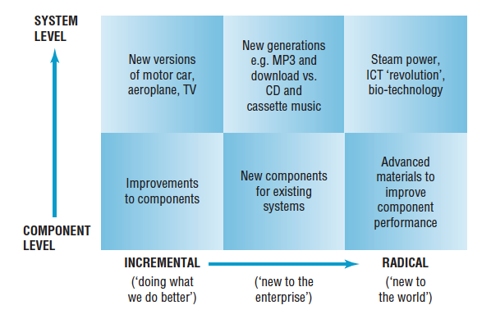
Types of Innovation
Figure 1.8 of the book illustrates the range of choices, highlighting the point that change can Ask the students to provide more examples and to populate the matrix. You can divide the students into groups and ask them to think of more examples of (i) radical, (ii) incremental, (iii) product, and/or (iv) service innovation

Slide 25
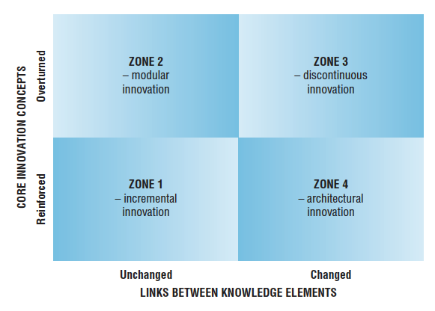
Knowledge architectures and innovation

Slide 26
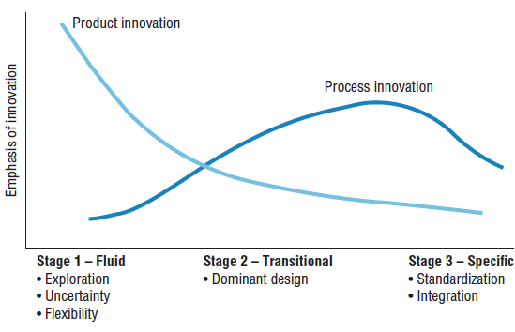
The innovation life cycle

Slide 27
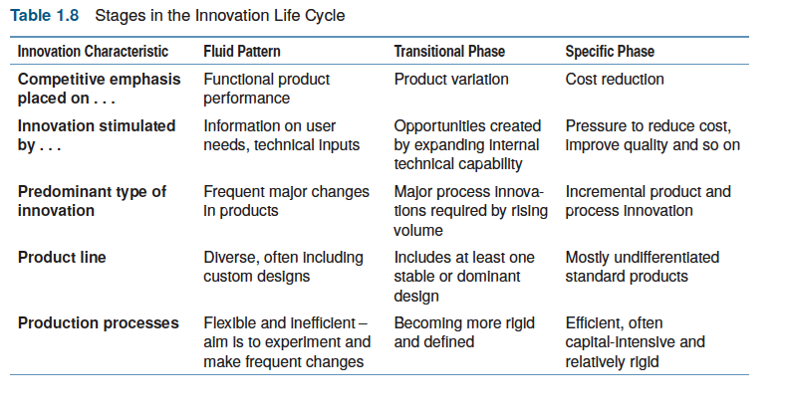
Stages in the life cycle

Slide 28
Discontinuous innovation
Triggers for discontinuity include:
New market emerges
New technology emerges
New political rules emerge
Running out of road
Sea change in values and public opinion
Changes in regulatory context
Fractures along ‘fault lines’
Architectural innovation/ business model innovation
Unthinkable events
Etc.

Slide 29
Summary
Innovation is about growth – about recognising opportunities for doing something new and implementing those ideas to create some kind of value. It could be business growth, it could be social change. But at its heart it is the creative human spirit, the urge to make change in our environment.

Slide 30
Summary
Innovation is also a survival imperative. If an organization doesn't change what it offers the world and the ways in which it creates and delivers those offerings it could well be in trouble.
And innovation contributes to competitive success in many different ways – it’s a strategic resource - helping to get the organization where it is trying to go, whether it is delivering shareholder value for private sector firms, or providing better public services, or enabling the start-up and growth of new enterprises.

Slide 31
Summary
Innovation doesn’t just happen – it is driven by entrepreneurship. This powerful mixture of energy, vision, passion, commitment, judgement and risk-taking – provides the engine behind the innovation process.
It’s the same whether we are talking about a solo start-up venture or a key group within an established organization trying to renew its products or services.

Slide 32
Summary
Innovation doesn’t happen simply because we hope it will – it’s a complex process which carries risks and needs careful and systematic management. Innovation isn’t a single event, like the light bulb going off above a cartoon character’s head. It’s an extended process of picking up on ideas for change and turning them through into effective reality.

Slide 33
Summary
We need to:
Understand what we are trying to manage – the better our mental models, the more likely what we do
with them in the way of building and running organizations and processes will work;
• Understand the how – creating the conditions (and adapting/configuring them) to make it happen;
• Understand the what, why and when of innovation activity – strategy shaping the innovation work
that we do;
• Understand that it is a moving target – managing innovation is about building a dynamic capability.

Slide 34
Innovation can take many forms, but they can be reduced to four directions of change:
• ‘product innovation’ – changes in the things (products/services) that an organization offers;
• ‘process innovation’ – changes in the ways in which they are created and delivered;
• ‘position innovation’ – changes in the context in which the products/services are introduced;
• ‘paradigm innovation’ – changes in the underlying mental models that frame what the organization
does.
Summary

Slide 35
Research repeatedly suggests that if we want to succeed in managing innovation we need to:
explore and understand different dimensions of innovation (ways in which we can change things)
manage innovation as a process
create enabling conditions to enable them to repeat the innovation trick (building capability)
focus this capability to move their organizations forward (innovation strategy)
build dynamic capability (the ability to reset and adapt their approaches in the face of a changing environment).
Summary

Slide 36
Any organization can get lucky once, but the real skill in innovation management is being able to repeat the trick. So if we want to manage innovation, we ought to ask ourselves the following check questions:
• Do we have effective enabling mechanisms for the core process?
• Do we have strategic direction and commitment for innovation?
• Do we have an innovative organization?
• Do we build rich proactive links?
• Do we learn and develop our innovation capability?
Summary

Slide 37

Videos
There are several short videos which can help explore and present the key themes of the chapter:
What is innovation?
Why does innovation matter?
The innovation imperative
Innovation model innovation ’
The language of innovation
Innovation management
Notes:
Short videos

Slide 38
Videos
You can also watch longer films covering key themes:
John Bessant explaining the challenge of Strategic innovation management
John Bessant explain the 4Ps model - Exploring innovation space
Joe Tidd discussing the question ‘Why innovate?’
Notes:
Short videos

Slide 39
Innovation managers in their own words
On the website there are several interviews with practising innovation managers which give an idea of the wide range of challenges in the field and the different areas (commercial and not-for-profit) in which innovation is playing a key role:

Slide 40

Creating value from ideas
Follow the link to watch a video by The School of Life on ‘How to be an Entrepreneur’
https://www.youtube.com/watch?v=lJjILQu2xM8

Slide 41
Creating and capturing value
Follow the link to watch Michael G. Jacobides’ TED Talk, ‘Creating and Capturing Value in Your Business Ecosystems’
https://www.youtube.com/watch?v=hxQHSyk5oyc

Slide 42
Blogs and podcasts
There are several podcasts picking up key themes around managing innovation as a process and some of the key variables:
Blog pieces here include innovation histories charting the ways in which innovation evolves and contributes – for example, ‘The birth of the bike’, ‘Sweeping the floor with innovation’ and the rise of the internet.

Slide 43
Cases
There is a wide range of case studies available on the website to help explore themes raised in the chapter. They can be found at https://www.johnbessant.org/cases

Slide 44
Cases
There are several case studies which highlight key themes in the chapter, including:
3M, Marshalls, Hella, Corning – in which you can see the emergence of such routines shaping their ‘personality’ over time

Slide 45
Cases
In particular the chapter mentions:
The dimming of the light bulb and the changing imaging industry, two examples of innovation patterns over time
Marshalls and Hella, case studies of innovation over several decades within a growing business from start-up to global players
Spirit a highly successful Russian company whose technology underpins most voice recognition systems around the world.
Several cases including Zara, Lego, Philips, Kumba Resources, Dyson and 3M showing how companies use innovation to create and sustain competitive advantage
Examples from the public and not-for-profit world including Aravind Eye Clinics, NHL Hospitals, Lifespring Hospitals and the Eastville Community Shop
Kodak and Fujifilm showing how disruption can affect well-established businesses and the innovation strategies they use to deal with it

Slide 46
Tools
The chapter introduces a variety of tools for helping answer the question of where and when to innovate, including:
The 4Ps approach to mapping innovation space
Blue Ocean strategy
Value curves
Competitiveness profiling
They can all be found here:

Slide 47
Activities
These are a few examples of activities which can help explore themes raised in the chapter. They can be used with individuals or groups and adapted for online and off-line/classroom settings.
You can find these and more here:

Slide 48
What is innovation?
Step 1. What is innovation? Open question for the classroom to brainstorm, generate a list with examples on the board.
Step 2. For the list of examples that has been generated, think of the ‘value’ that those innovations created.

Slide 49
What is innovation?
Step 1. Ask the class to think of one word that defines innovation. Put the class in groups and ask each group to coin a definition of innovation using that one word that they presented individually.
Step 2. Give the students different roles. For example, in R&D, marketing, production, supply chain, accounting, finance, etc. and repeat the task. This will help them understand what innovation is from the functional perspective inside organisations.

Slide 50
What is innovation?
Variant 1. Ask the class in groups to draw an image of what innovation is. Ask each group to present their pictures.
Variant 2. Ask the class in groups to draw an image of what innovation is. Ask the other group to define and decipher what they see on the drawing.
Variant 3. As in Activity 2 – give members of the group different roles, then ask them to define and decipher the drawing. This will help them to understand the problem of communication inside an organization where members have different priorities.

Slide 51
Why innovation matters
Ask the students to prepare a quick presentation on why innovation matters as a short introductory discussion project to open up the theme.
In doing so research websites, print media, TV or other locations for statements of how companies position innovation at the core of what they do and how they present themselves. What are they talking about and why does it matter to them? What dimensions do they stress? What examples do they give?

Slide 52
Ask your students to discuss who innovation matters to, for example:
  Entrepreneurs starting up a venture
  Established enterprises trying to grow
  Governments (local and national)
  Trade and sector bodies
  Supply chain ‘owners’
You might use this video to help stimulate discussion:
https://youtu.be/WHvTSAk3X60
Who does it matter to?

Slide 53
Innovation isn’t easy
This activity involves exploring examples of innovation failure and the difficulties of translating a good idea into practice.

Slide 54

Innovation isn’t easy
The Museum of Failure gives a wide range of examples of innovations which have failed, including many coming from some of the world’s biggest business names. Invite students to explore the site and distil a list of the many ways in which good ideas can fail:
https://museumoffailure.com/

Slide 55
Creating value through innovation
Choose a case study – there are many examples here:
Let’s take the example of Aravind eye care:
Variant 1: Ask your students to think of the value created through this innovative case.
Variant 2: Using the Aravind case, ask the students to make a map of radical, incremental, product, and service innovations and the value these innovations create.

Slide 56
Platform innovation
Activity - get students to read this blog piece and reflect on examples of platform innovation which they can identify

Slide 57
Creating value through innovation
Ask your students to list all the different ways in which innovation might create some kind of value – and try to find ‘real world’ examples of such innovations.
On the website you can find a version of this exercise
Ask your students to provide their examples.

Slide 58
Exploring innovation space
There is a video to begin to explore the model here
And there is a detailed classroom activity suitable for group work
The video of ‘Finnegan’s fish bar’ shows how you can use the model with a simple organisation to explore innovation space. One activity is to get the class to watch it and then choose another simple example – a shop, a restaurant, etc. – and construct a 4Ps map of where and why it might innovate.

Slide 59
Classifying innovation
Ask your students to think of a list of innovations and classify them in terms of the themes in this section – incremental or radical, products or service, etc.
On the website there is an exercise to help you do this:

Slide 60
The innovation life-cycle
Activity: Get students to read the blog pieces on ‘The birth of the bike’ , ‘Sweeping the floor with innovation’ and other innovation stories. Get them to try to map their history using concepts from the life-cycle model
Video versions of these and other innovation histories are here

Slide 61
Architectural and component innovation
Ask your students to think of a list of innovations and classify them in terms of architectural and component innovation.
On the website there is a framework to capture your answers.

Slide 62
Innovation routines and culture
This activity helps explore the different ways in which organizations have learned to manage innovation.

Slide 63
Strategic advantage through innovation
On the website there is an exercise to help you explore possible sources of strategic advantage through innovation.

Slide 64
Strategic advantage through innovation
Think about an organization with which you are familiar and about the other firms or players in its sector. How do they choose to try and position themselves for strategic advantage - and how do they use technology to help them do so? They may try and offer the lowest prices - and have heavy investments in clever machines which help them achieve this. Or they may try and offer the best designs - and back this up with a commitment to design and R&D.
Try and research the strategies of not only one firm but of several within the sector and build up a picture of how the sector is shaped by firms using technology to try and gain competitive advantage. You might like to use table 1.3 to help you think about how they are doing so - and to record your thoughts.

Slide 65
Sectoral patterns of innovation
On the website there is another simple activity suitable for individuals or groups to explore patterns of innovation over time and across sectors:
You could use this in conjunction with the case studies of the imaging, lighting or music industries, also available here:
https://www.johnbessant.org/cases

Slide 66
Sector innovation patterns
Imagine you work for a firm involved in children's toy manufacturing. Now try and list the major changes in that sector over the past 25 years in terms of what contributes to competitiveness. Who (which firms) have been the winners and losers, and why? You are trying to get a feel in this for how technological change can shape the competitive dynamics of an industry so think about questions like these:
How has the industry changed - and how has technology helped (or could it help) deal with these changes?
What new technologies have emerged - and how have they been used?
What are the main market demands (e.g. price, quality, design, customisation, speed of response, etc.) and how has technology affected the ability of firms to offer these?
If a new entrant came into the industry what would he/she have to offer to become a market leader - and how might technology help them do so?
You may need to spend some time researching the wider sector to build up this picture. Try and summarise your research in the form of short 'bullet points' which highlight the strategic role which technology plays. You might like to use the framework here to help:
https://johnbessant.org/wp-content/uploads/2020/06/Sector-Innovation-Patterns.pdf

Slide 67
Innovation makes a difference
This activity involves students looking at the case examples of different ways in which innovation can make a difference and then researching and presenting back their own examples:

Slide 68

Activity/game: Paper Planes
This is a game that helps students understand that for innovation to happen it needs a product, a process, a market, a business model. It also needs to involve strategy, collaboration, technology, marketing, communication, etc.
This is a simple interactive game that can act as a good ‘icebreaker’ with students, but also with innovation management generally, helping participants to think holistically about the challenges of innovation.

Slide 69
Forces for innovation
This activity explores some of the forces shaping the emergence of innovation and how they play out over time.

Slide 70
Innovation and knowledge
There are several activities designed to explore the relationship between knowledge and innovation.
Case study and activity: Strategic advantage through innovation
Harvesting knowledge crops

Slide 71
Changing context for innovation
Find a company whose experience you want to study. Using Table 1.5: Challenges in the innovation context – take a detailed interview with the general manager and explore the ways in which the changing context affects their business. Key context changes might include:
Acceleration of knowledge production
Global distribution of knowledge production
Market expansion
Market fragmentation
Market virtualization
Rise of active users
Growing concern with sustainability issues

Slide 72
Assessment/ discussion questions
Does innovation matter? In what ways does it make a difference – economically, socially, living standards, humanitarian, etc.
2. Give ways in which strategic advantage can come from innovation. List the ways in which an organization does (or doesn’t) use innovation to get and stay ahead of competition.

Slide 73
Assessment/ discussion questions
How are ‘innovation’ and ‘entrepreneurship’ connected and how they are essential for survival and growth on a country/company level.
4. Imagine Nick Smith has an innovative product idea. What does he need to start with? What could be the first steps and what are the major challenges/barriers to expect?

Slide 74
Assessment/ discussion questions
5. How does innovation contribute to competitive advantage? Support your answer with illustrations from both manufacturing and services.
6. Does innovation matter for public services? Using examples indicate how and where it can be an important strategic issue.
7. You are a newly-appointed director for a small charity which supports homeless people. How could innovation improve the ways in which your charity operates?

